Slide 1
Spectral Solver for PDE
Jeffrey Low
Jacob Rohozen

Slide 2
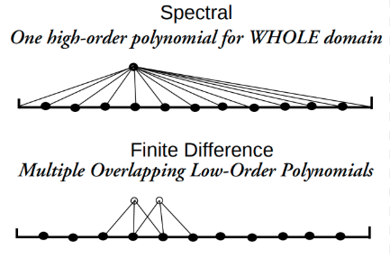
Why Spectral Solvers?
Traditional methods (finite difference)
Approximates using neighbours (local)
Spectral methods
Approximates entire solution across grid
Exponentially faster convergence (smooth problems)
Notes:
In finite difference methods, derivatives are approximated locally which can require many points and more steps to get a good accuracy
In spectral methods, a single global higher-order polynomial is used to represent the whole domain, this can lead to faster convergence when the solution is smooth

Slide 3
Pseudo-Spectral method workflow
Transform Spatial domain to Fourier Space (FFT)
Solve the simple ODEs for Fourier coefficients
Advance in time
Inverse transform to physical space (IFFT)
Repeat until Limit
PDE
Fourier Transform
ODEs
Time step (Fourier space)
Inverse Fourier Transform
Repeat until limit
Notes:
Spectral solvers can be differentiated between full and pseudo spectral solvers.
Pseudo spectral solvers operates between the fourier domain and time domain where at each point in time,
the spatial domain is converted to fourier domain
To break down the PDEs into ODEs that can be solved with a polynomial solver
The resultant is converted back to physical space and
Advanced in time
This process repeats until the stipulated time limit

Slide 4
Full Spectral method workflow
Transform Spatial & Time domain to Fourier Space (FFT)
Solve the resulting ODEs with spatial coordinates
Step in time within Fourier space
Repeat time stepping until limit
Transform back to spatial domain (IFFT)
PDE
Fourier Transform
ODEs
Time step (Fourier space)
Repeat until limit
Inverse Fourier Transform
Notes:
However, in full spectral solvers, both the time and space data are transformed into fourier domain where
The ODEs are solved in each time step for the entire spatial coordinate
Time is stepped within this fourier step before repeating the ODE solver for the spatial coordinates in the specific time step
Time stepped is repeated until stipulated time limit
All the resultant data are then transformed back to spatial domain using IFFT

Slide 5
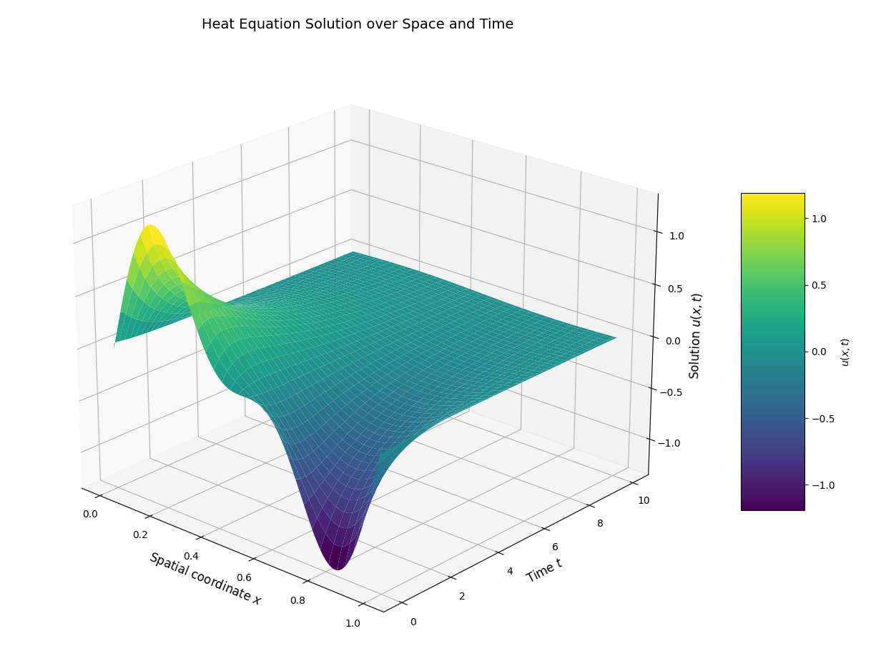


1D Heat
$$u_{t}=α∇^{2}u$$
Fourier transform in $x$
Solve ODE
IFFT back to space
Time step
Notes:
In the 1D heat equation, a pseudo spectral solver was used to solve the initial condition.
In this slide we show the initial sine condition converging to a stable 0 due to the positive and negative integral being symmetrical
Using fftw, we first moved the spatial values into fourier before solving the ODE
IFFT is done before time stepping forward.
This process is repeated with the given 10second limit.
This shows the sine wave converging to a line as time approaches infinity

Slide 6
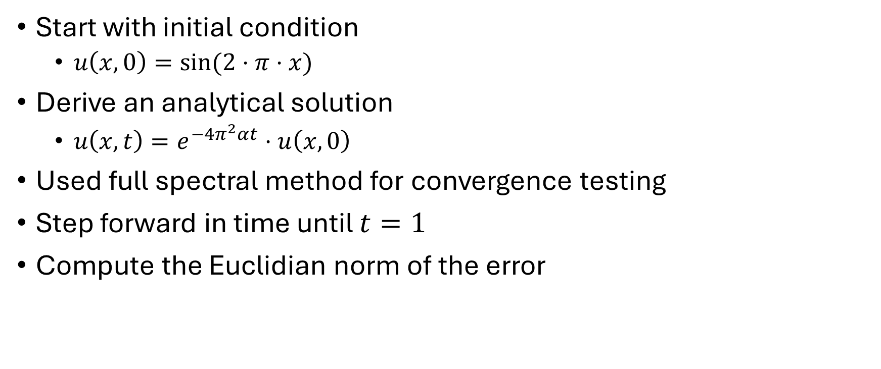
1D Heat convergence
Start with initial condition
$u\left(x,0\right)=sin⁡(2⋅π⋅x)$
Derive an analytical solution
$u\left(x,t\right)=e^{−4π^{2}αt}⋅u\left(x,0\right)$
Used full spectral method for convergence testing
Step forward in time until $t=1$
Compute the Euclidian norm of the error
Notes:
We also computed convergence with the pseudo-spectral and it gave the exact same result
t=1 corresponds to about 67% of original height
Didn’t choose a very large time – any solver that goes to 0 after a long time could produce

Slide 7
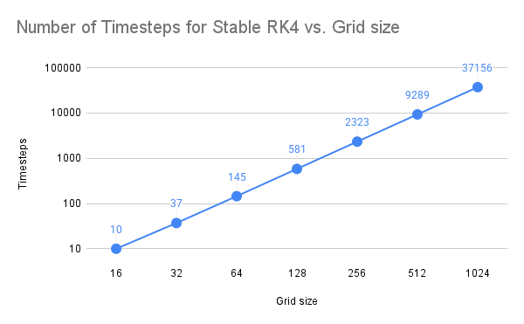
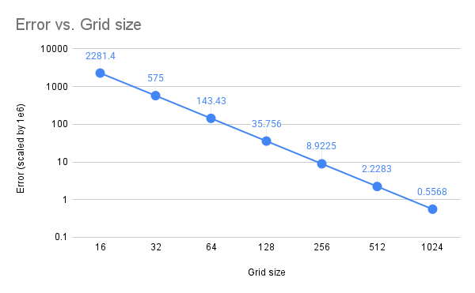
1D Heat convergence: RK4
RK4 does not converge for insufficiently small dt
Does not meet stability criteria
However, once a small enough dt is reached, the error does not improve by further decreasing dt
Notes:
Slops of both lines ~4

Slide 8
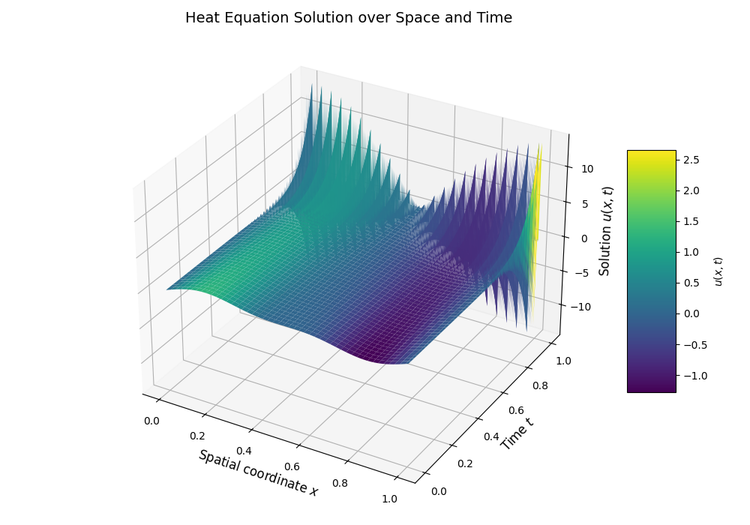
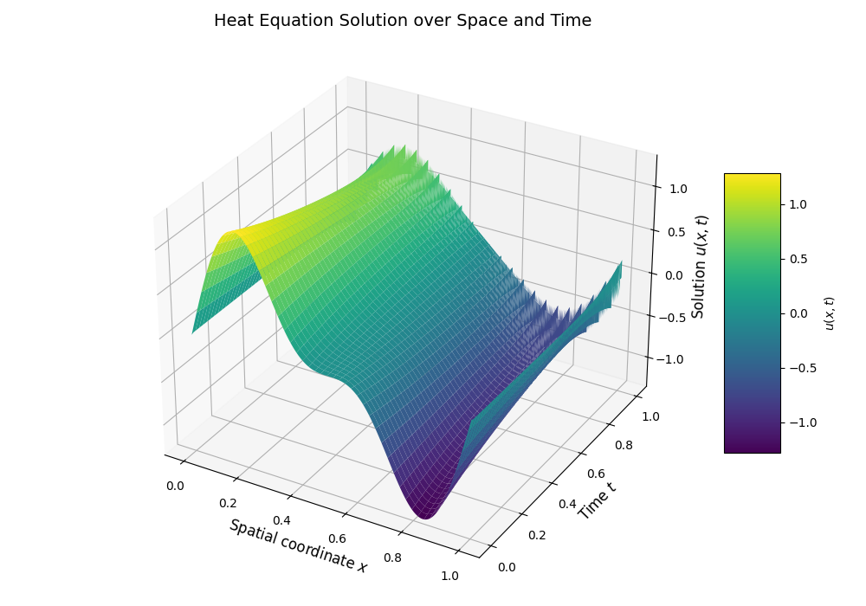
1D Heat convergence: RK4 Stability
Grid spacing = 1/512
Timesteps: 9286
Error = 23.842
Timesteps: 9287
Error = 5.3729e-3
Notes:
Remember the grid is only [0,1]
23 is a big error for a sine wave in that range…

Slide 9
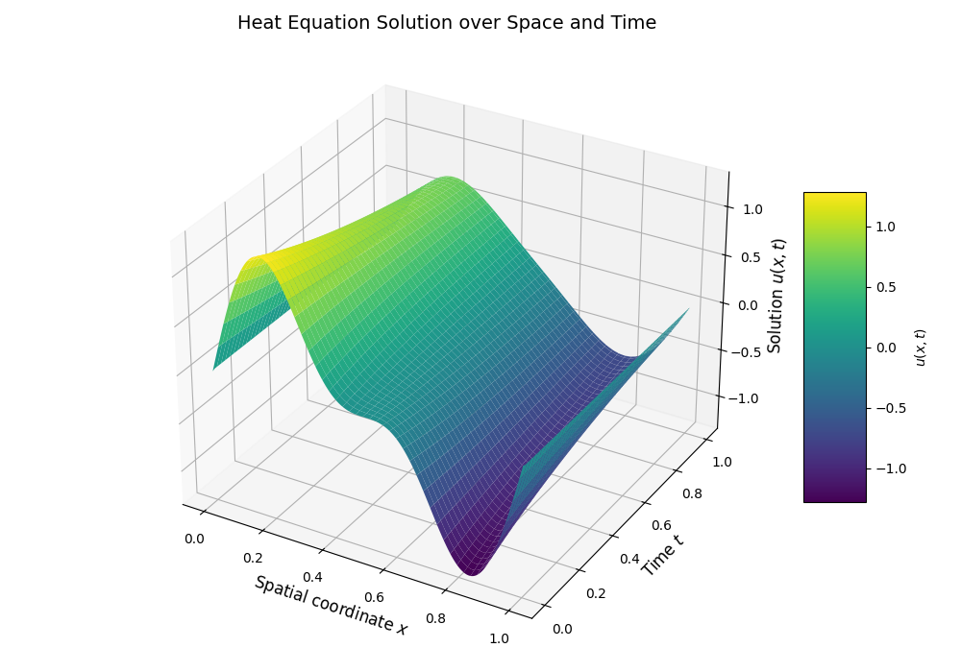
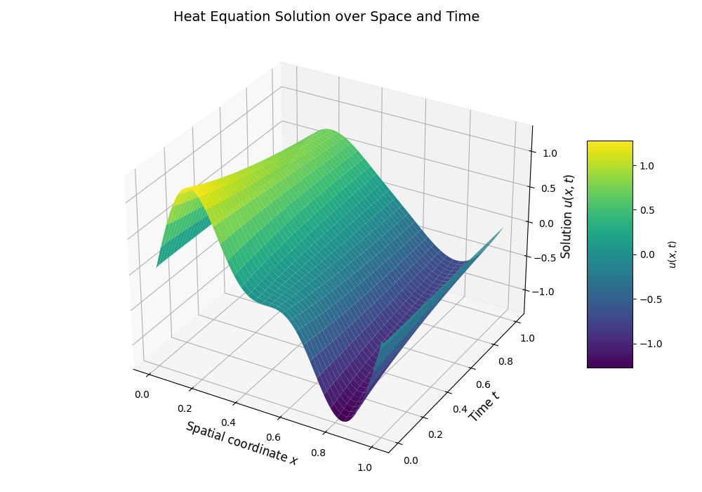
1D Heat convergence: RK4 Stability
Grid spacing = 1/512
Timesteps: 9289
Error = 2.283e-6
Timesteps: 20000
Error = 2.283e-6

Slide 10
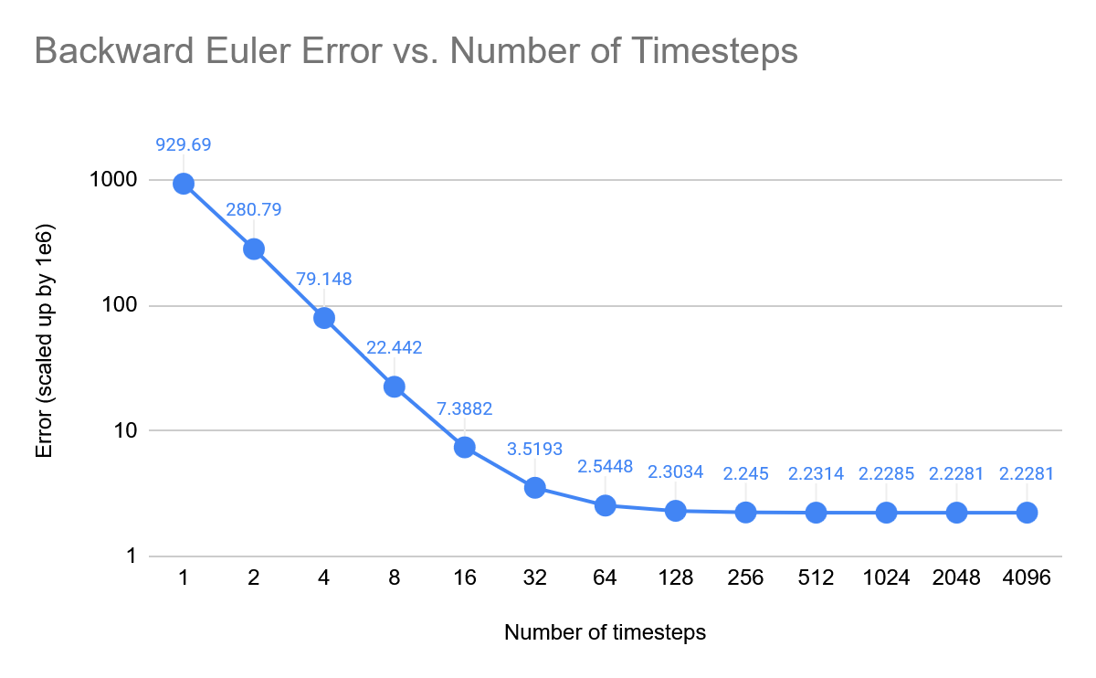
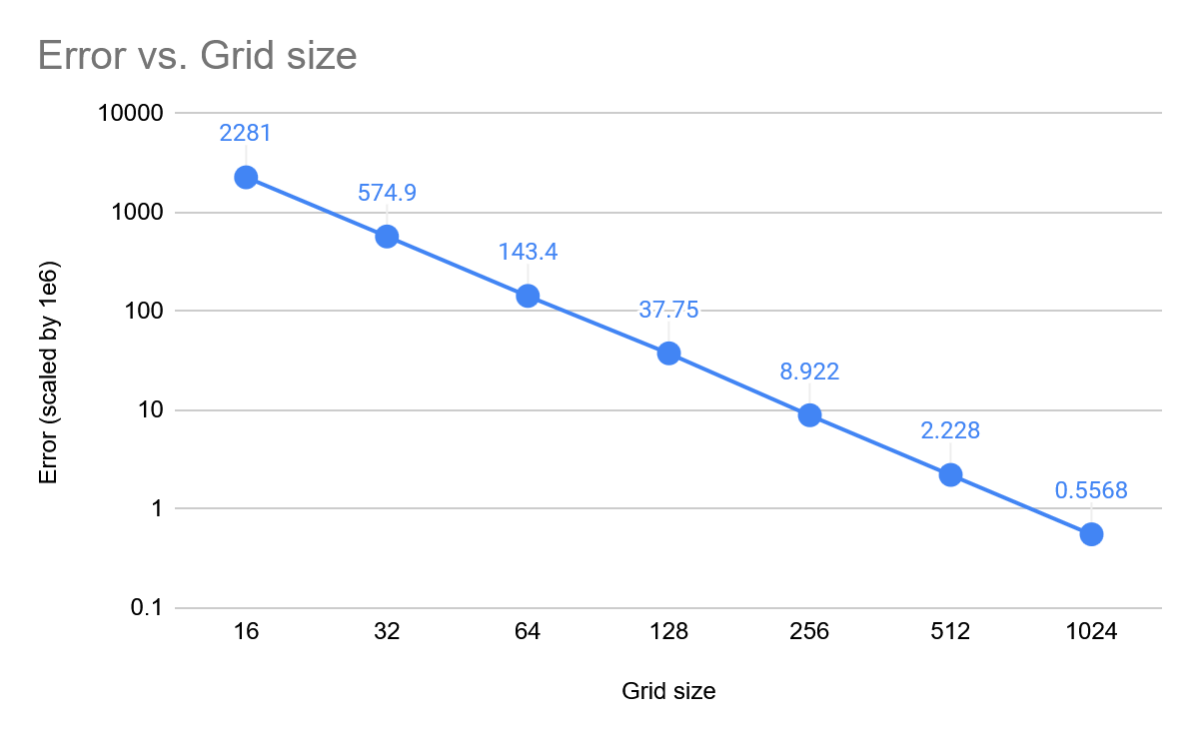
1D Heat convergence: Backward Euler
Converged faster than RK4
No stability issue (implicit integrator)
Grid spacing = 1/512
Timesteps = 8192

Slide 11
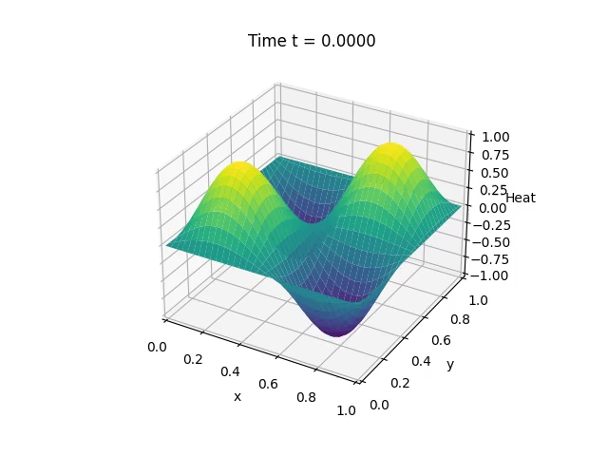
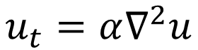
2D Heat
$$u_{t}=α∇^{2}u$$
Spectral diffusion
Alpha: 0.01
Grid size: 128x128
Time step: 0.0001
Steps: 50000
2D Fourier transform
Solve ODE for each Fourier mode
Solves in time-stepping (backward Euler and RK4)
Pseudo Spectral solver helps incorporate source term effects in time independently
Notes:
The same as 1D heat was done in 2D heat. This is done with the source in mind where the source term is added to the grid at every time step. This can be seen in the next slide, where

Slide 12
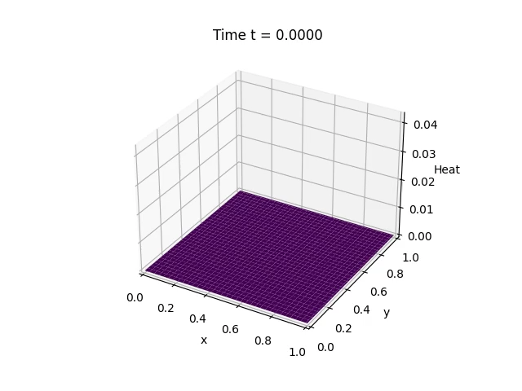
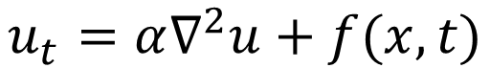
2D Heat with source
$$u_{t}=α∇^{2}u+f(x,t)$$
Spectral diffusion with source
Alpha: 0.01
Grid size: 128x128
Time step: 0.0001
Steps: 50000
2D Fourier transform
Solve ODE for each Fourier mode
Solves in time-stepping (backward Euler and RK4)
Pseudo Spectral solver helps incorporate source term effects in time independently
Notes:
A source term was added iteratively to the 2D heat with source. This works well with the pseudo spectral solver as it would give us flexibility in implementing different sources that can be added at every time step as it transforms in time.
Full spectral solver with a source can be difficult as: 1. source at each timestep
You cant just FFT the source once up front. Evaluation of the source term at every RK step and every time step is needed and FFT is done on the fly
2. Extra fft
For every sample of the source term, a forward fft is needed to get its spectral coefficients, for rk4, 4 extra steps are needed per step
3. Keeping accuracy
Ensure each source term is injected correctly in the right rk stage to ensure being in fourth order

Slide 13


2D convection
$$u_{t}+v⋅∇u=D∇^{2}u$$
Transport term in physical space
Velocity: x=1.0 y=0.5
Grid size: 128x128
Diffusion coefficient: 0.01
Time step: 0.0001
Steps: 50000
Pseudo-spectral and full spectral implemented in RK4 and backward Euler
Expected full spectral to be more accurate but saw no difference
Notes:
Next, in the 2D convection solver, a pseudo and full spectral solver was implemented in both rk4 and backward euler.
In our implementation, we expected the full spectral to be more accurate as errors would more likely accumulate due to hardware rounding and saturation for floats and conversion between the number of steps used in pseudo spectral solver
however we saw no differences between the implementations
This is likely due to the smaller and simpler experiments in our project which likely gave values well that worked well with fftw

Slide 14


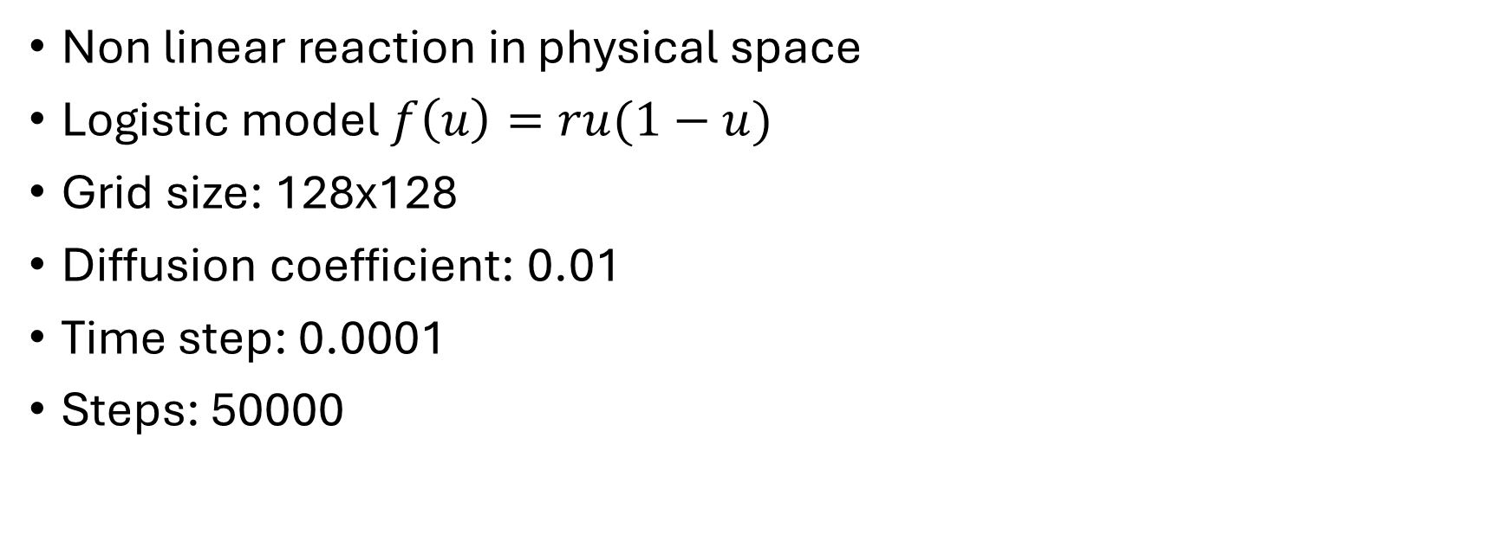
2D reaction
$$u_{t}=D∇^{2}u+f(u)$$
Non linear reaction in physical space
Logistic model $f\left(u\right)=ru(1−u)$
Grid size: 128x128
Diffusion coefficient: 0.01
Time step: 0.0001
Steps: 50000

